Slide 1
Applying the Cultural Preparedness Process Model for Intervention Development Amongst
High School Students:
A Report from India and Bangladesh
Presented by
Abhishek Ghosh, Joseph Chakma, Poonam Jain,
Rayan Miranda, Gideon Arulmani
The Promise Community College, Bangalore, India
DISRUPTED FUTURES
International lessons on how schools can best equip
students for their working lives
OECD conference: 27, 28 and 29 October 2021

Slide 2
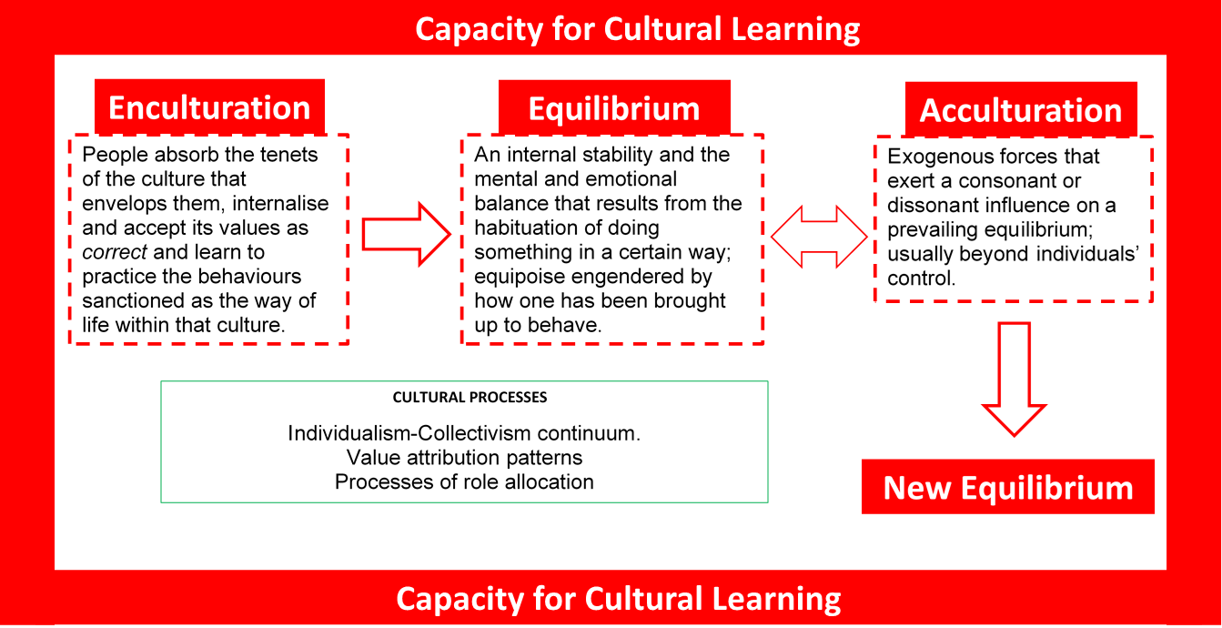
Cultural Preparedness: Key Concepts

Slide 3
Macro Conditions, Trends and Transformations
Global conditions and transformations form the backdrop against which human engagement with work and career occurs.
Macro, external factors that affect the individual/group but over which the individual/group has little or no control.
Social philosophies, economic trends, political changes, technological advances, and natural phenomena.
For example, economic liberalisation and globalisation have brought a wide range of new occupations into emerging economies that have a significant impact on career development processes in these economies.

Slide 4
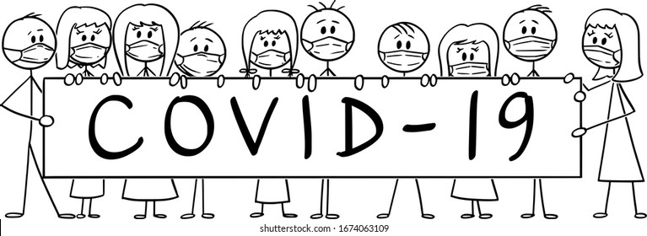
One of the most pervasive and
disruptive
macro conditions, we have experienced in our lives

Slide 5
Disruptions in India
Annual Status of Education Report (ASER) 2020
Trends over time: ASER 2018 to ASER 2020
Nationwide survey, to look how pandemic, is affecting schooling and learning opportunity of children.
Total Households sampled = 118,838, Total Households surveyed = 52,227.
Children reached = 59,251, Children age range = 5 to 16 years
Schools surveyed = 8,963.
Trends over time: ASER 2018 to ASER 2020

Slide 6
Disruptions in India
Annual Status of Education Report (ASER) 2020
Trends over time: ASER 2018 to ASER 2020
Has there been a shift in school enrolment and school type?
Slight increase in withdrawals from Private schools and increase in government school enrolment: Could indicate economic decision by the parents, due to the income stress caused by the pandemic (Private schools costs are higher; government schools are free)

Slide 7
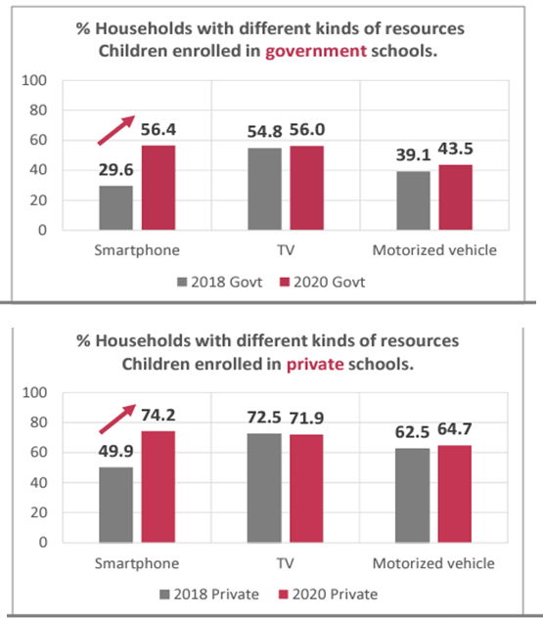
Disruptions in India
Annual Status of Education Report (ASER) 2020
Trends over time: ASER 2018 to ASER 2020
Were efforts made to gain access to online resources?
Between 2018-2020, there was little change in purchase of other household appliances such as TV or vehicle.
But a sharp increase in purchase of smartphones is visible in the data across all SES groups.

Slide 8
Disruptions in India
Annual Status of Education Report (ASER) 2020
Trends over time: ASER 2018 to ASER 2020
Help at Home?
Learning support for about 75% of students shifted to home.
Parents take primary responsibility.
Elder siblings play an important role.
“No Help at Home” increases with Grade Level.

Slide 9
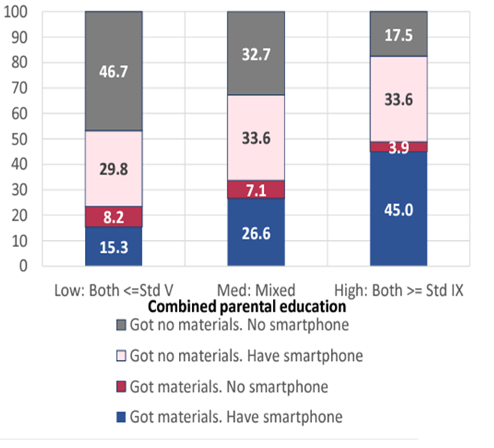
Disruptions in India
Annual Status of Education Report (ASER) 2020
Trends over time: ASER 2018 to ASER 2020
Materials Sent Home?
Only 1/3rd of children received some material at home.
Whatsapp was the main medium (>70%).
1/3rd did not receive any material although they had a smartphone.

Slide 10
Disruptions in India
Annual Status of Education Report (ASER) 2020
Trends over time: ASER 2018 to ASER 2020
Who did activities? What’s the Difference?
30% of children did not engage in learning activities.
Learning activities are more frequent in families with higher parental education.
Interestingly, even if no material were received more than 1/3rd of children engaged in learning at home in all types of families.

Slide 11
A Survey of Social Cognitions
Pertaining to Career Development Amongst Grade 10 Students and their Parents
The Promise Foundation. (2020-21). Bangalore.
My childhood is lost
I will not have a good career
I don’t know
enough.
My career plan is wrecked
My future is dim
I have not learned anything this year

Slide 12
Disruptions in Bangladesh
BRAC Institute of Governance and Development 2020
Asadullah, N., Bhattacharjee, A., (2020). COVID-19, Schooling and Learning. University of Malaya.
Sample size: 4,672 households – 5,193 students.
Both children and mother interviewed.
Lower socio-economic background – rural and urban slums
Phone interview.
Measurements: Time-use module (activity-prompt), Before-after comparison (change).
Trends over time: BIGD nationwide survey (N=3000) of rural households in December 2017 with BIGD survey in May-June 2020.

Slide 13
Disruptions in Bangladesh
BRAC Institute of Governance and Development 2020
Asadullah, N., Bhattacharjee, A., (2020). COVID-19, Schooling and Learning. University of Malaya.

Slide 14
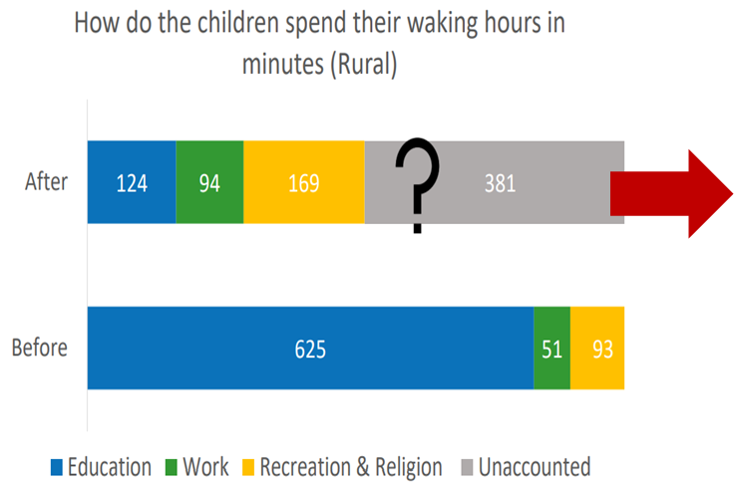
Disruptions in Bangladesh
BRAC Institute of Governance and Development 2020
Asadullah, N., Bhattacharjee, A., (2020). COVID-19, Schooling and Learning. University of Malaya.
6 hours (50% ) of waking hours. unaccounted for.
Learning time has decreased.

Slide 15
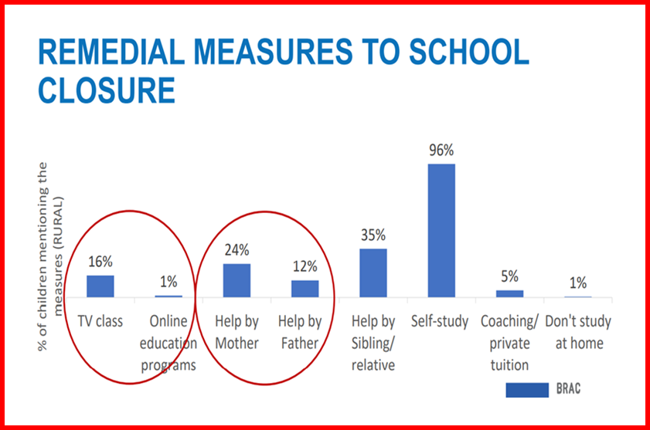
Disruptions in Bangladesh
BRAC Institute of Governance and Development 2020
Asadullah, N., Bhattacharjee, A., (2020). COVID-19, Schooling and Learning. University of Malaya.
Television is more frequently mentioned than online resources.
Self-Study has significantly increased

Slide 16
Key Observations
In pre-COVID times, learning was centered around teacher.
Learning environments have shifted away from school to the home.
Home Learning Environments (HLE) have come to center stage.
The responsibility for providing learning support has transferred mainly to parents and to some extent elder siblings.
During school closure, other methods, materials and modes have been tried: hybrid learning, content delivery through digital modes.

Slide 17
Key Observations
The primary tools for learning resources have shifted to virtual modalities: Television and Internet.
Television is used more often than the Internet.
Parent literacy plays a key role in engagement with learning support resources; engagement is lower when parent literacy is low.
Older students have consistently engaged with self-study.
The Home Career Learning Environment (HCLE) plays a key role in engagement with career development.

Slide 18
The word Jiva means ‘life’ in most of the Indian languages.
The Jiva careers programme is based on the premise that a healthy career is integrally connected to one’s life.
For pandemic, Jiva was adopted into online format.
Outreach to 3,000 students online (smartphones, computers), addressing well-being and person-centered career guidance.

Slide 19
Principle 1
Development as a Spiral:
A non linear approach to career development
Development occurs in a spiral!
May not necessarily always point in the ‘forward’ direction.
There may be a requirement to let go of earlier positions and begin anew.

Slide 20
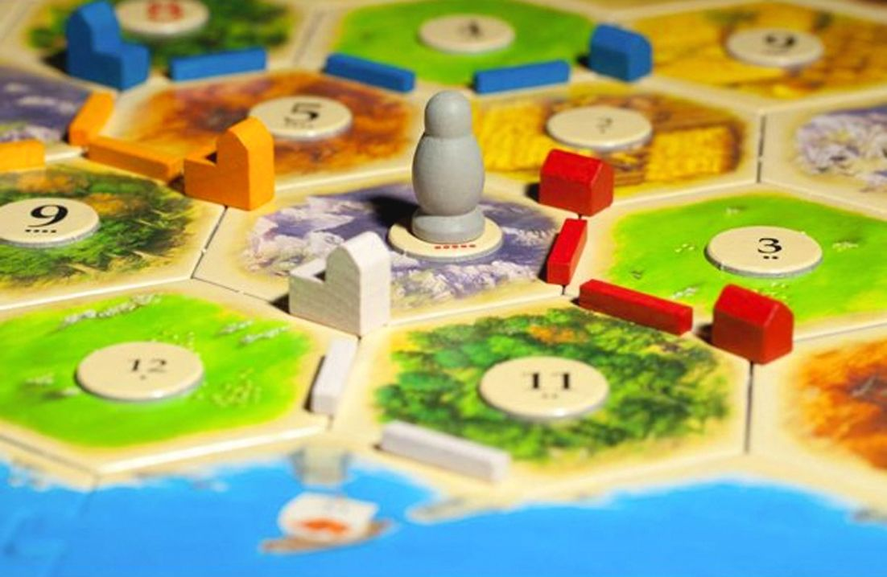
Principle 2
Re-discover Multidimensionality of Self
Accountant to Toy Maker
What is seen may only be what is required or allowed – a result of the forces of enculturation.
Career Guidance could help students develop skills to continually discover new dimensions to themselves.

Slide 21
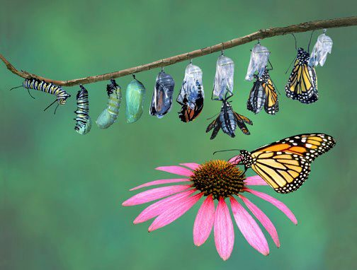
Principle 3 The Changing and the Unchanged
A career develops in finding the balance between what changes and what does not change so easily.
A self-sustaining way of dealing with change would be to discover, accept and strengthen aspects of oneself that are stable and relatively constant.

Slide 22
Targets for Career Development Support
Address negative career beliefs.
Focus on strengthening ongoing self-discovery.
Focus on re-interpreting world of work information.
Strengthen the home learning environment.
Valorise parent role.
Provide parents with tools and support.
Strengthen teacher/counsellor engagement with parent.
Strengthen self-mediation.

Slide 23
Stop calling us the “Pandemic Generation”!
Response from a group of
Grade 10 (15 year old) boys and girls in Bangalore, India

Slide 24
Disruptions are in the present. They need not lead to “disrupted futures”.

Slide 25
Appendix

Slide 26
Global Disruptions
UNESCO: Disruptions to schooling and learning proficiency Gustafsson, M. (2021). Pandemic-related disruptions to schooling and impacts on learning proficiency indicators: A focus on the early grades
UNESCO Institute of Statistics. https://unesdoc.unesco.org/ark:/48223/pf0000377781/PDF/377781eng.pdf.multi
September 2021: 117 million students are still affected by complete school closures in 18 countries.
54% loss in contact time translates into loss of about 1 year’s learning.
Only if the Grade 3 learners learn 10% more than a normal year’s worth of learning, will they return to the original proficiency trajectory only in year 2030.
581 million children in Grade 1 to 8, will be pushed below the proficiency threshold.

Slide 27
Disruptions in India
Annual Status of Education Report (ASER) 2020
Trends over time: ASER 2018 to ASER 2020
What were the devices used for access to online resources?
Smartphone (rather than computer) was the most common device used.
% of private school homes with smartphones at home were greater.
At the same time government school parents were also purchasing smartphones.

Slide 28
Disruptions in India
Annual Status of Education Report (ASER) 2020
Trends over time: ASER 2018 to ASER 2020
Home-School Contact
No contact in 2/3rd of the sample regardless of school type.
The lack of contact was higher in families of lower educated parents.

Slide 29
Disruptions in Bangladesh
BRAC Institute of Governance and Development 2020
Asadullah, N., Bhattacharjee, A., (2020). COVID-19, Schooling and Learning. University of Malaya.
Child engagement increases with parental education.
Engagement is poor both for TV and Internet when parent education is low.

Slide 30
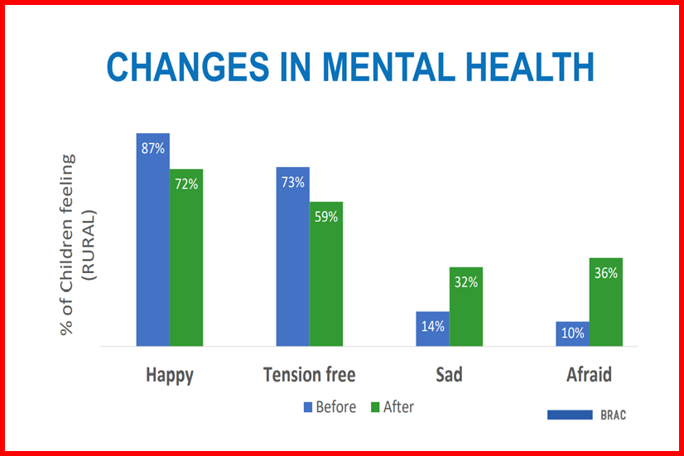
Disruptions in Bangladesh
BRAC Institute of Governance and Development 2020
Asadullah, N., Bhattacharjee, A., (2020). COVID-19, Schooling and Learning. University of Malaya.
Personal sense of wellbeing has decreased.
Negative emotions have increased.

